Slide 1
Module 11 Guided Lab - Streaming Dynamic Content using Amazon CloudFront
Made for Professor Lanham A. by Amrit Singh

Slide 2
AGENDA
Accessing the AWS management console
Task 1: Lab Preparation
Task 2: Create an Amazon CloudFront Distribution
Task 3: Create an Amazon Elastic Transcoder Pipeline
Task 4: Test Playback of the Dynamic (Multi Bit-Rate) Stream

Slide 3
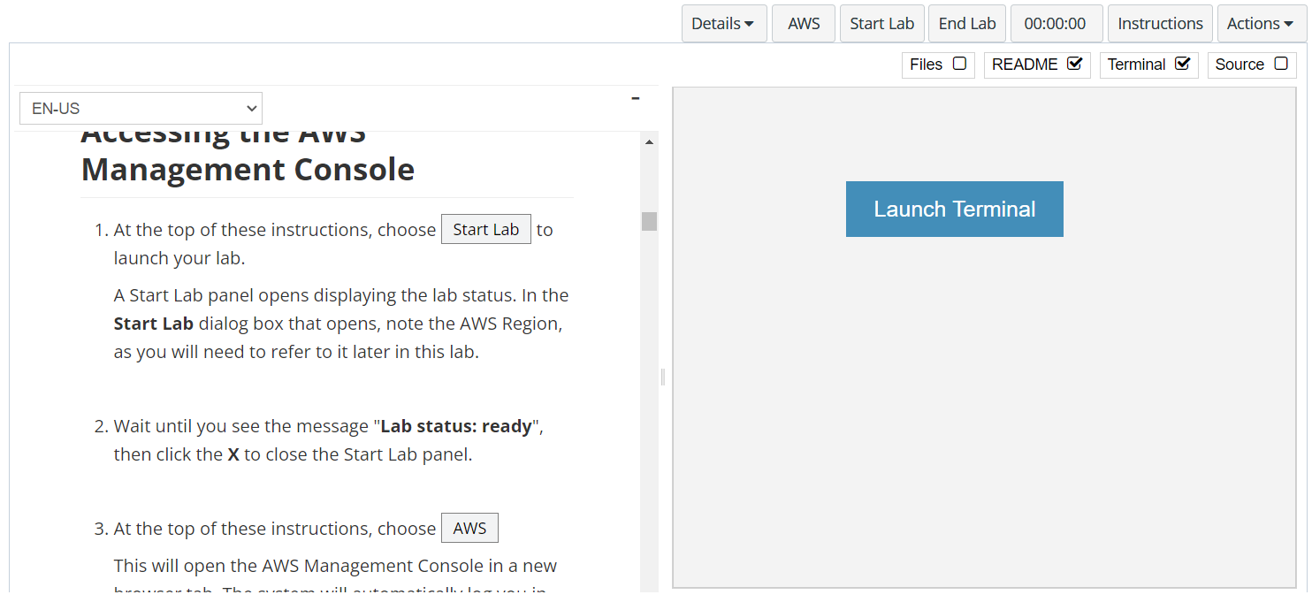
In aws labs click on start lab

Slide 4
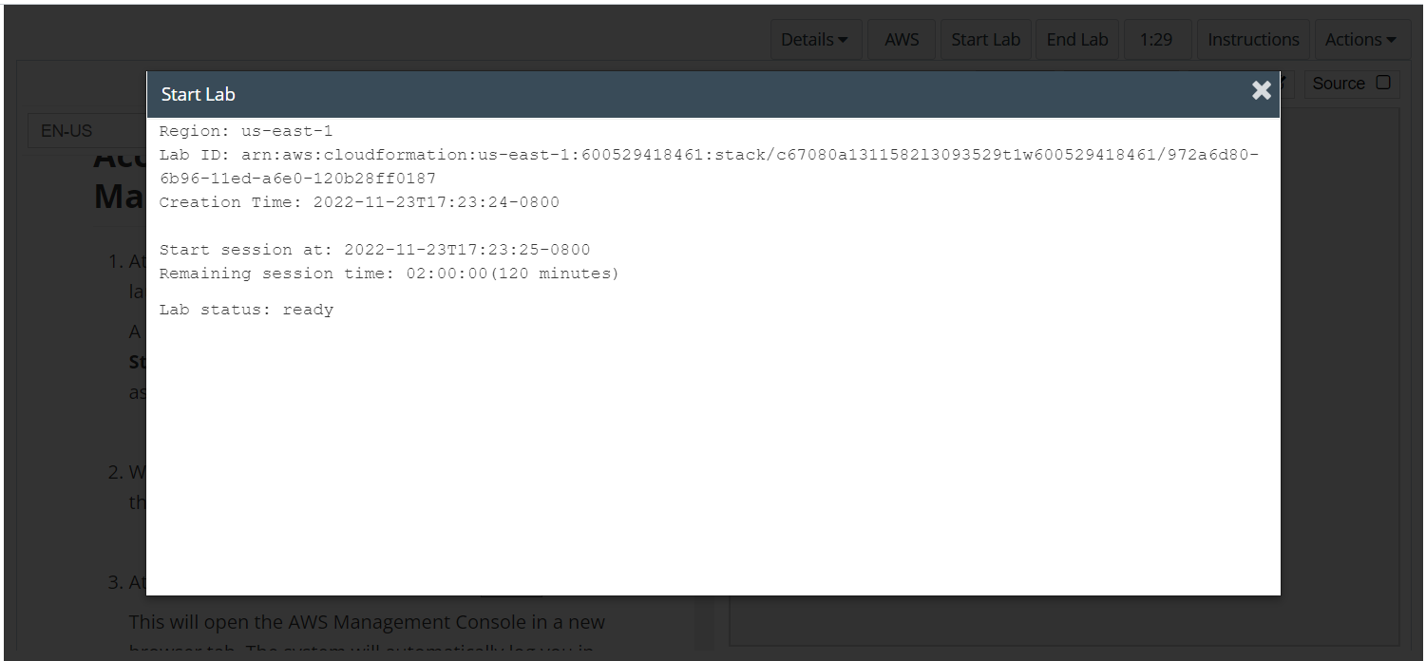
Wait to see lab ready status in the window then press x and click on aws to launch console

Slide 5
Task 1: Lab Preparation

Slide 6
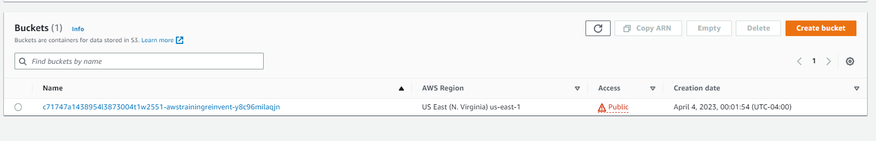
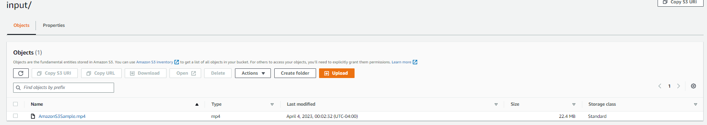
OPEN THE s3 CONSOLE
In the AWS Management Console, on the Services menu, choose S3.
An S3 bucket containing the string awstrainingreinvent should be present. Note the Region that the bucket is in, and open the bucket.
Open the input folder. It contains a video file named AmazonS3Sample.mp4.

Slide 7
Task 2: Create an Amazon CloudFront Distribution

Slide 8
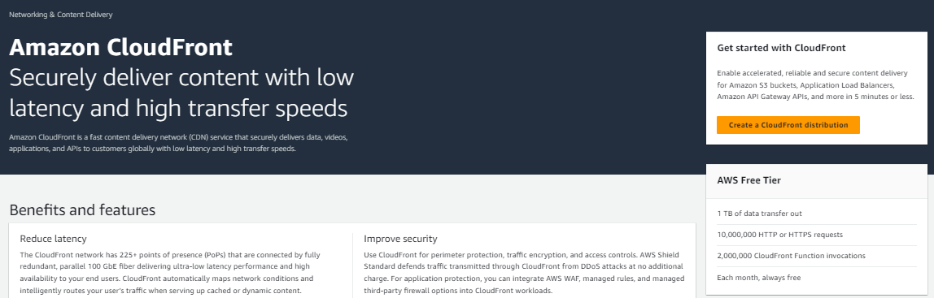
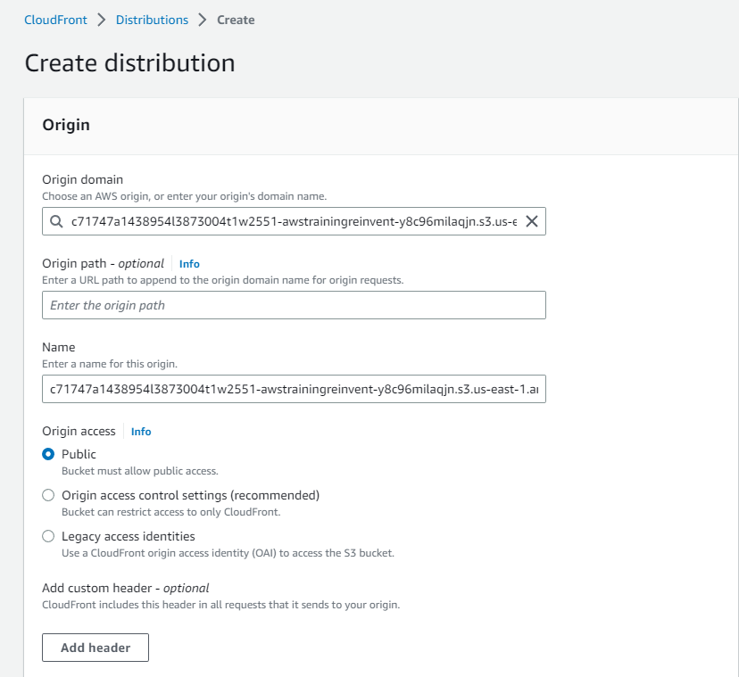
Open the cloudfront console and configure a distribution
On the Services menu, choose CloudFront.
Choose Create Distribution
Under the Web section of the page, choose Get Started.
Under Origin Settings section of the page, enter the follow information:
Select the Origin Domain Name field. A list of S3 buckets will appear. Choose the one that was created earlier that has awstrainingreinvent as part of the file name.
Under Restrict Bucket Access select No.
Scroll to the bottom of the page, then choose Create Distribution.

Slide 9
Task 3: Create an Amazon Elastic Transcoder Pipeline

Slide 10
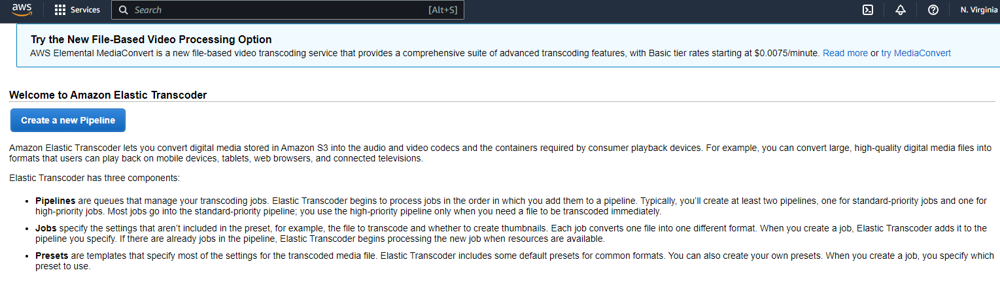
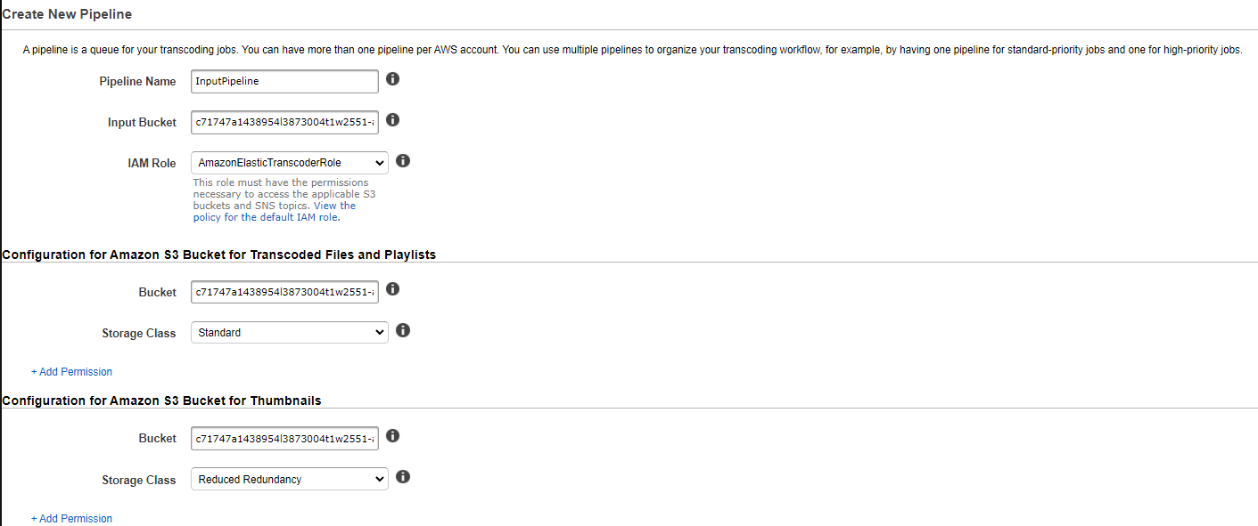
Open the elastic transcoder page
In the AWS Management Console, on the Services menu, choose Elastic Transcoder.
In the navigation bar of the Amazon Elastic Transcoder console, select the same Region that the S3 bucket was created in.
On the Pipelines page, choose Create a new Pipeline.
For Pipeline Name, enter InputPipeline
For Input Bucket, select the awstrainingreinvent S3 bucket.
For IAM Role, under Other roles, select AmazonElasticTranscoderRole
In the Configuration for Amazon S3 Bucket for Transcoded Files and Playlists section, enter the follow information:
Under Bucket, select the awstrainingreinvent S3 bucket.
Under Storage Class, select Standard.
In the Configuration for Amazon S3 Bucket for Thumbnails section, enter the following information:
Under Bucket, select the awstrainingreinvent S3 bucket.
Under Storage Class, select ReducedRedundancy.
Choose Create Pipeline.

Slide 11
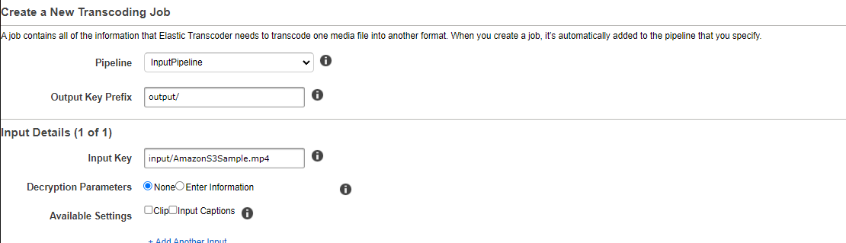
Open the elastic transcoder page, create a job and configure input details
On the Pipelines page, choose Create New Job to create a transcoding job. You create the job in the pipeline (queue) that you want to use to transcode the video file.
For Pipeline, select InputPipeline.
For Output Key Prefix, enter output/
For Input Key, select the input file labeled input/AmazonS3Sample.mp4.

Slide 12
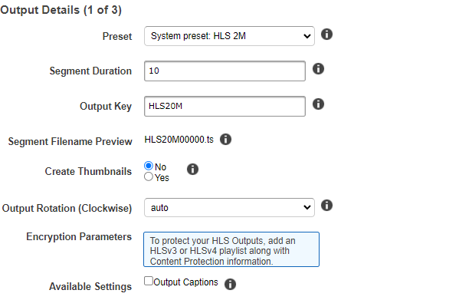
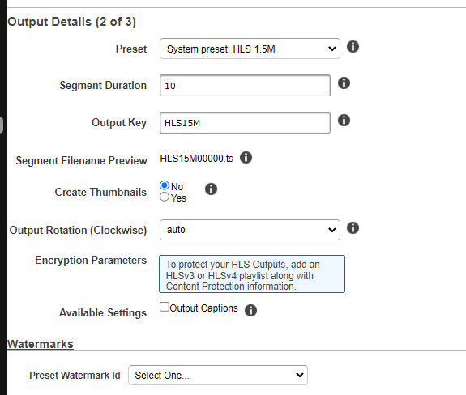
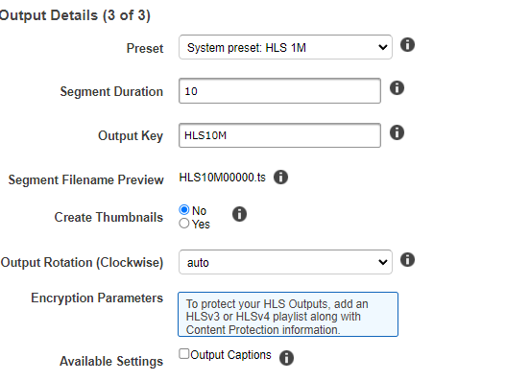
Open the elastic transcoder page, create a job and configure output details
For Preset:, select System preset: HLS 2M
For Segment Duration, enter 10 (which is the HLS default).
For Output Key, enter the unique prefix HLS20M to name the segments created using this preset.
Click + Add Another Output and repeat the steps above to generate segments for presets HLS 1.5M and HLS 1M and then provide the respective prefix names:
HLS15M
HLS10M

Slide 13
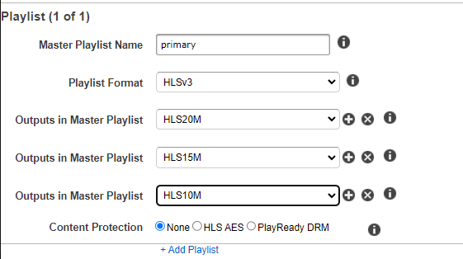
Open the elastic transcoder page, create a job and configure PLAYLIST details
Under Playlists (Adaptive Streaming), choose Add Playlist, then configure:
Playlist Name : primary
Playlist Format: HLSV3
Select all the three outputs, which were entered in the previous section, to include them in this playlist by selecting the + option.
Choose Create New Job.

Slide 14
Task 4: Test Playback of the Dynamic (Multi Bit-Rate) Stream

Slide 15
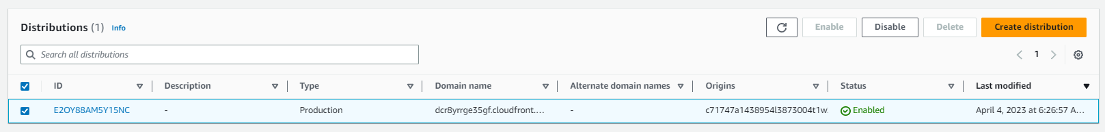
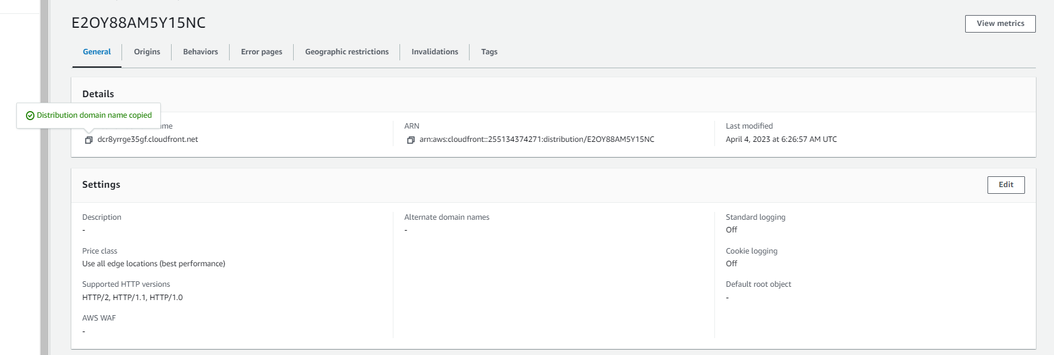
Obtain an Amazon CloudFront Domain Name
In the AWS Management Console, on the Services menu, choose CloudFront.
Select the Amazon CloudFront distribution that was previously created, and verify that the Distribution Status has changed from InProgress to Deployed.
Proceed to the next step only after the Status changes to Deployed.
Select the Distribution by selecting the square box to the left of the Distribution.
Choose Distribution Settings.
Copy the Domain Name and paste it into a text editor.

Slide 16
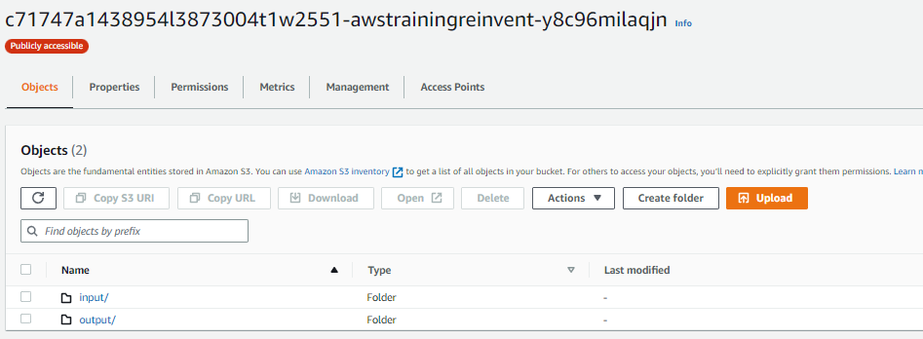
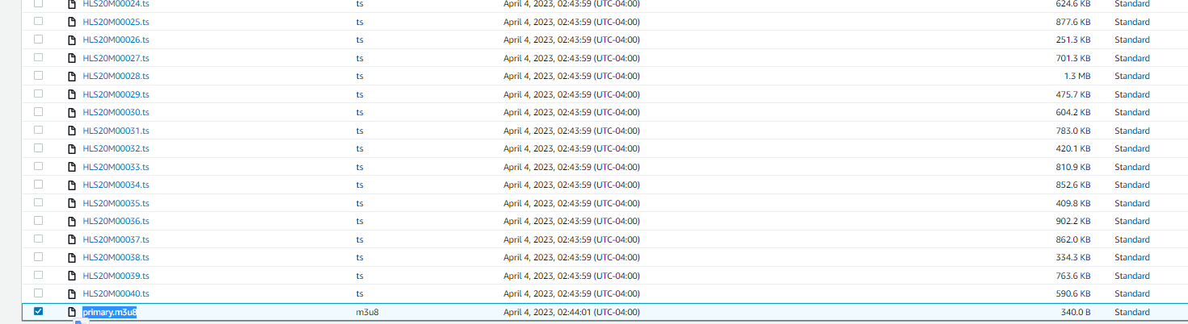
Open the s3 console in aws and open the training bucket
On the Services menu, choose S3.
Select the awstrainingreinvent S3 bucket.
Open the output folder (which contains the output of the transcoding job) and select the primary.m3u8 playlist file.
In a text editor, construct the URL by appending /output/primary.m3u8
to the end of your CloudFront domain name.

Slide 17
Open the url in a browser window
The new URL should look similar to: d1ckwesahkbyvu.cloudfront.net/output/primary.m3u8
Type the URL into the default browser of an iOS or Android device. If you do not have a mobile device available, type the URL into a browser on your computer
The stream should start playing on your device and dynamically request the relevant segments based on your bandwidth and CPU conditions

Slide 18
THANK YOU
Amrit Singh

